Slide 1
Port scanning detection using Machine learning
Group members:
Shiva Prasad Aggayala - 46233865
Mohan Kumar Padmanabha - 45758875
Srisai Raviteja Marupeddi - 45756546

Slide 2
Introduction
Port scanning is a typical method used by cyber attackers to look for vulnerabilities and deplete a target's resources.
NMAP is the most widely used port scanning tool in the world.
It handles Transmission Control Protocol/Internet Protocol (TCP/IP) communication.

Slide 3

Data set description
In the data set we can see that the file has the network capture pcap file transcribed into a csv file.
This data set was clearer to us and more understandable as we have a strong background in Networking.
This is a very systematic data set generated by the network devices.
The data which is being used in our project is the MAWIlab dataset and the malicious data set is generated on virtual network.

Slide 4
Merging data files
This code works with three different data sets malicious_dataset.csv, attack_labels.csv and normal_dataset.csv.
These three files have been merged into a file named CSV3.csv.
Loading this data set for modification using panda’s library.
Shuffling the data to get uniformity and randomness in the data.

Slide 5
Reducing features
The dataset contains columns which has same values through out the dataset or null values or zeros , these values have been removed from the data frame using drop () function.
This increases the efficiency of the code and reduces execution time.

Slide 6
Modification of data
Encoding the labels and column ip.src in the dataset to numerical values for anomaly detection.
Converting Hex and other strings into int and float for data analysis.
Replacing null and NaN values with zeros.

Slide 7
Implementation of ML models
Isolation forest ( unsupervised model):
This is an unsupervised Machine learning algorithm .
It detects global outliers in the dataset.
The accuracy score for this algorithm is 77%.
There is no much scope in hyper parameter tuning as it is unsupervised model.

Slide 8
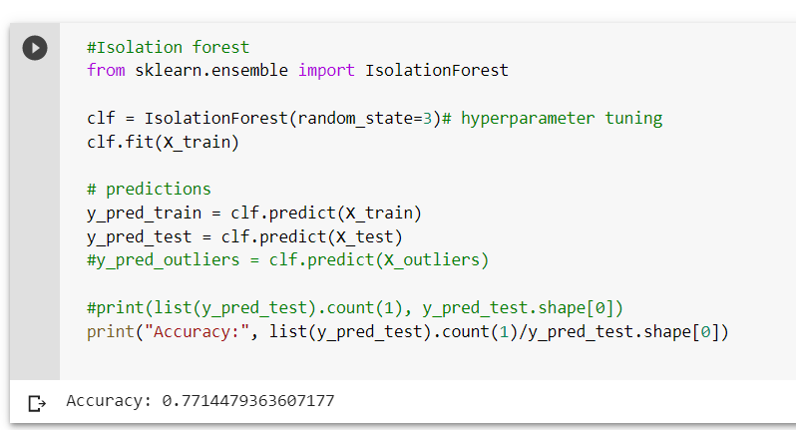
Iforest Result:

Slide 9
KNN Algorithm
KNN classifier is a supervised ML model.
Less scope in hyper parameter tuning
We classifying each data point in data frame to the nearest neighboring value so in this implementation we comparing with nearest three neighbors.
This algorithm gives 99% accuracy.
The data is classified into 33 classes. One of which is normal network traffic.

Slide 10
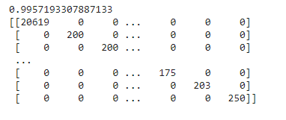
KNN result:

Slide 11
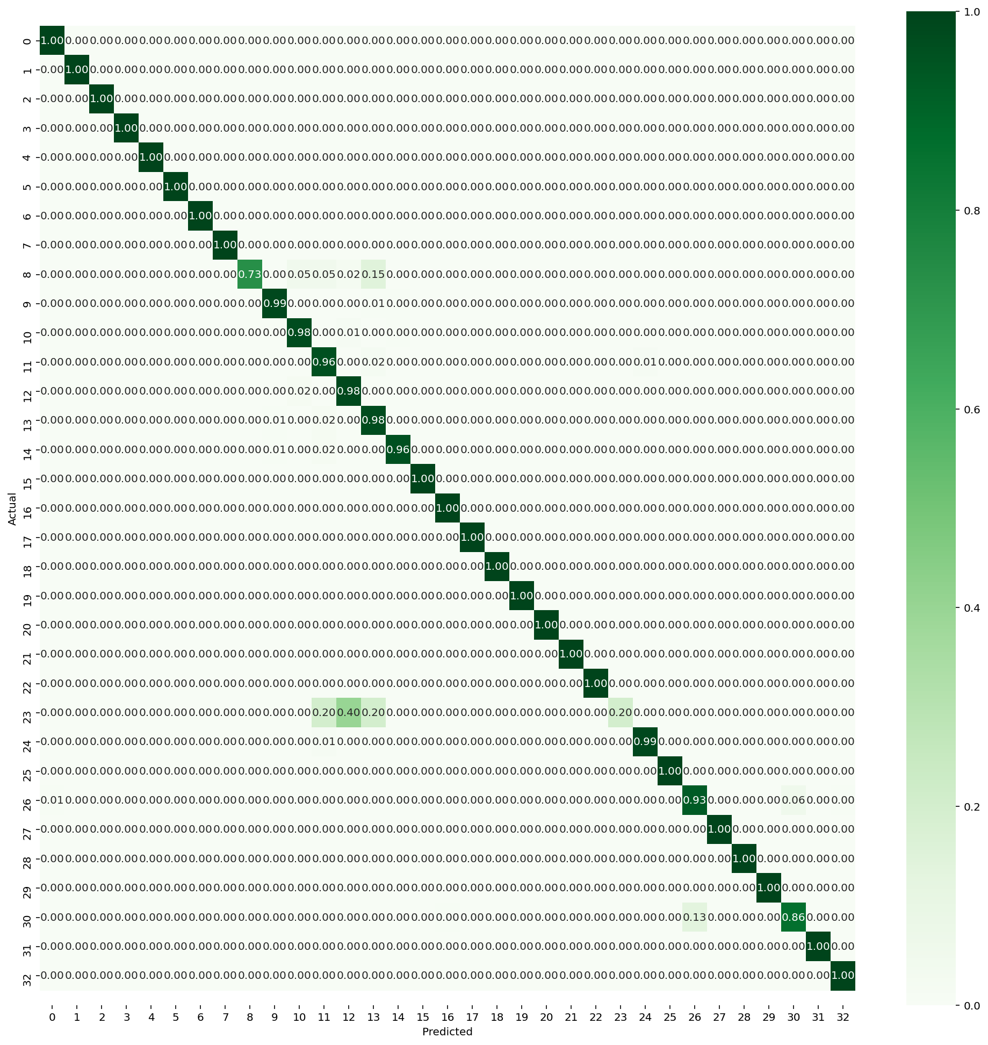
Confusion matrix of KNN:

Slide 12
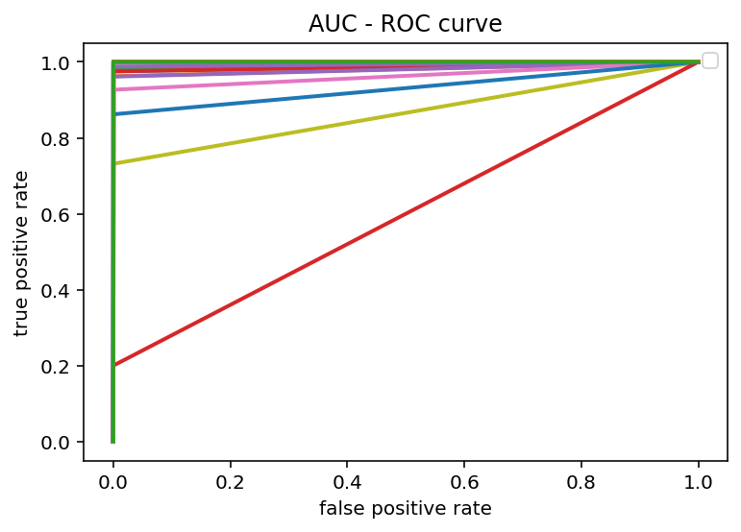
AUC-ROC curve

Slide 13
Random forest:
Random forest is a supervised learning algorithm.
It is more flexible and easy to use machine learning algorithms that provides great outcomes even without hyper-parameter tuning.
On executing random forest on our dataset we get 99.99% accuracy. This is the most efficient algorithm for this type of dataset.

Slide 14
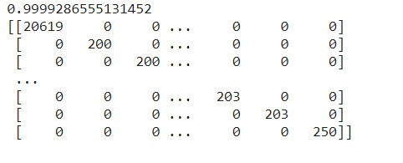
Random forest results:

Slide 15
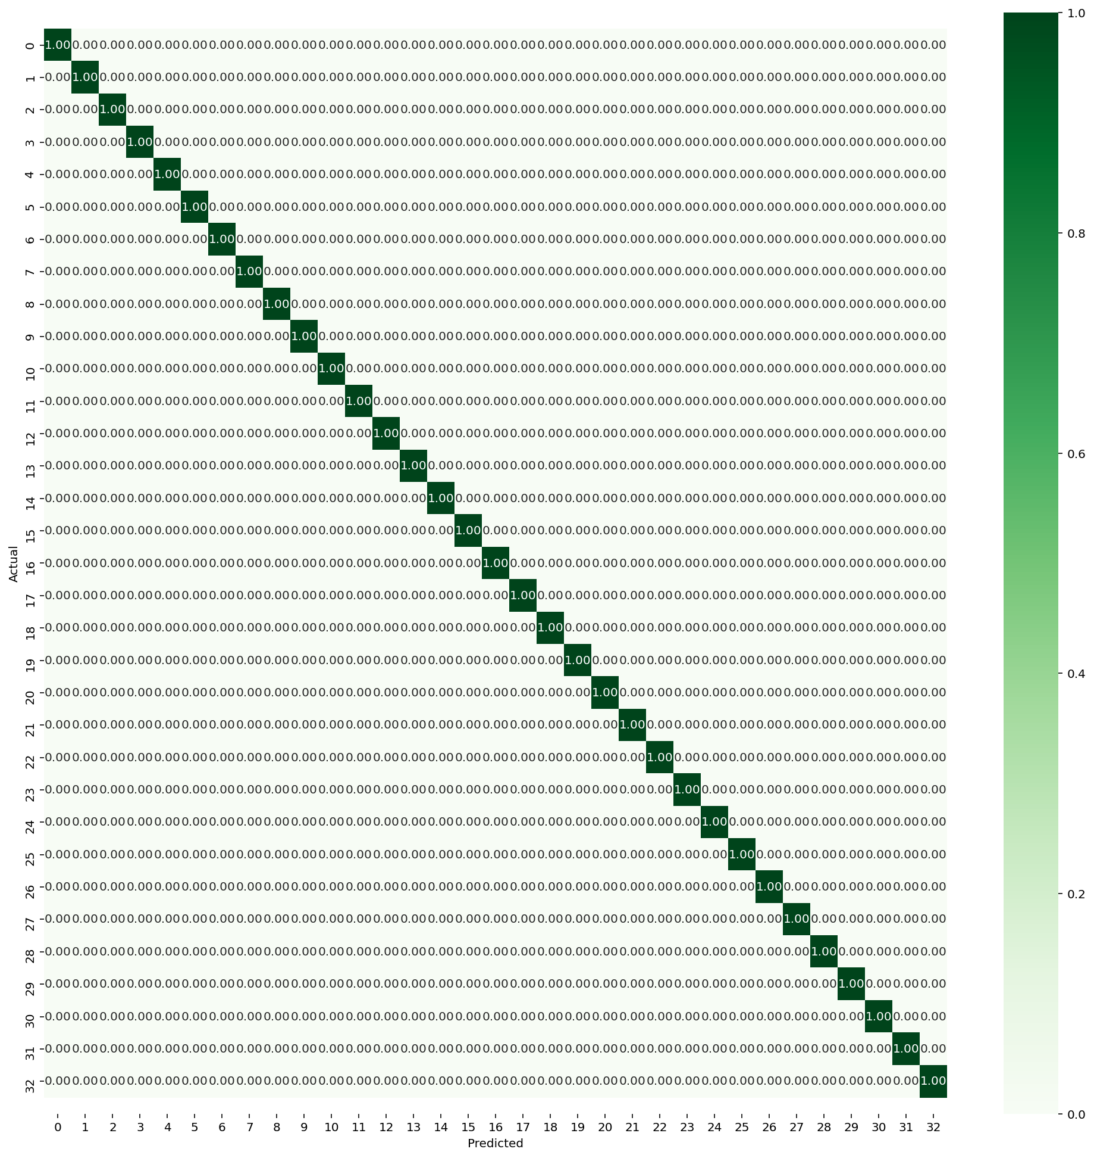
Random forest confusion matrix

Slide 16
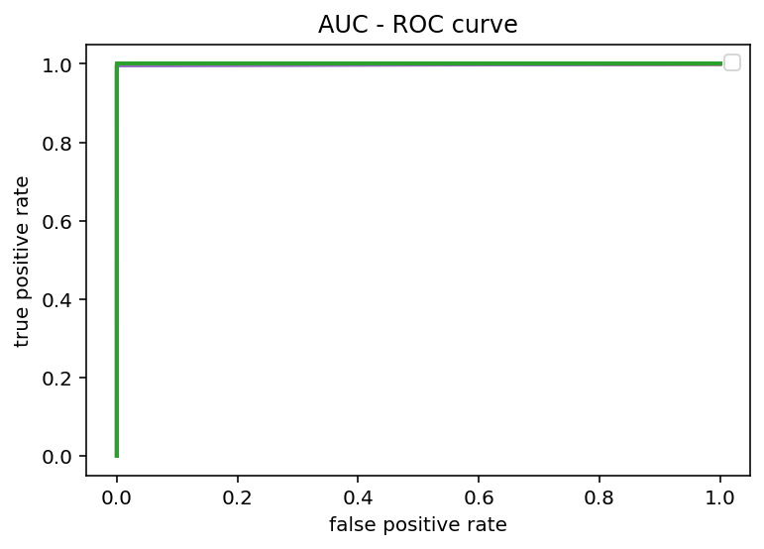
Random forest AUC-roc curve:

Slide 17
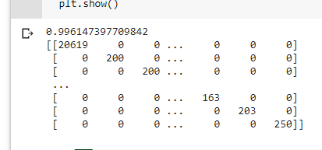
SVM ( support vector machine):
Support Vector Machine (SVM) is a supervised machine learning algorithm which can be used for both classification or regression challenges.
primarily, it is used for Classification problems in Machine Learning.
SVM also gets an accuracy of 99% and above. Below is result of SVM

Slide 18
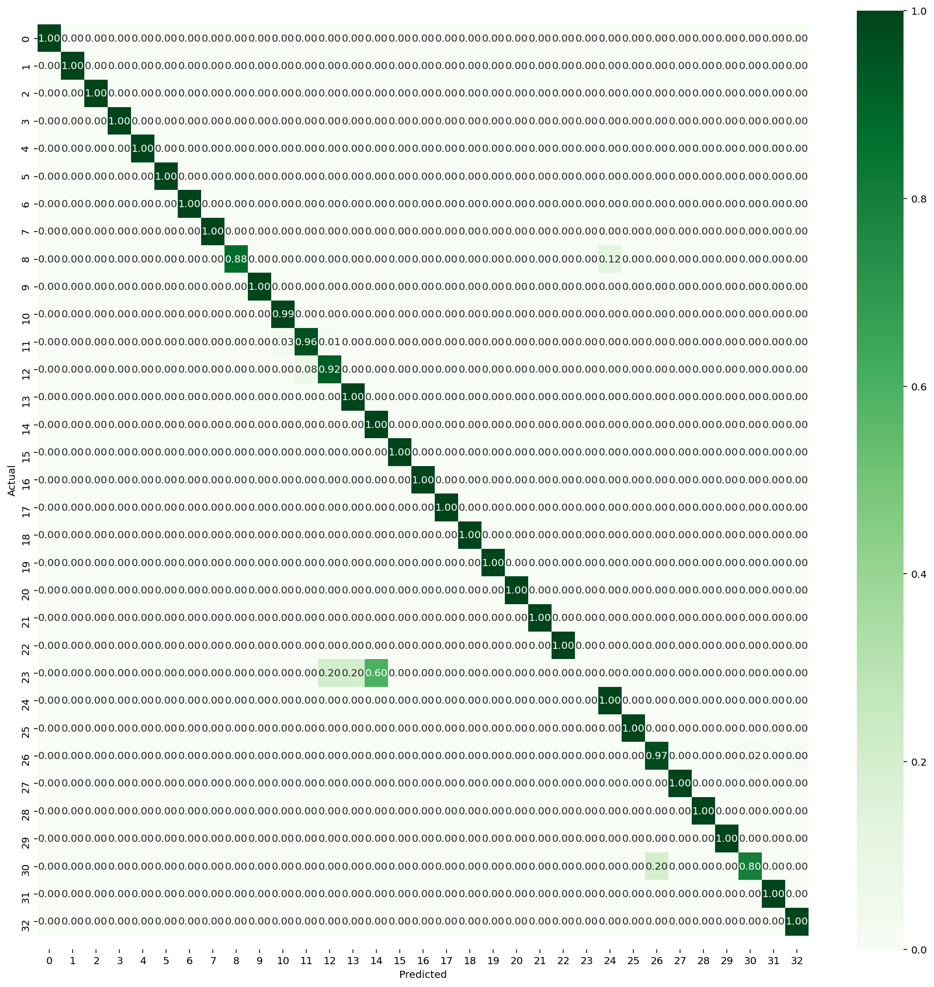
SVM confusion matrix:

Slide 19
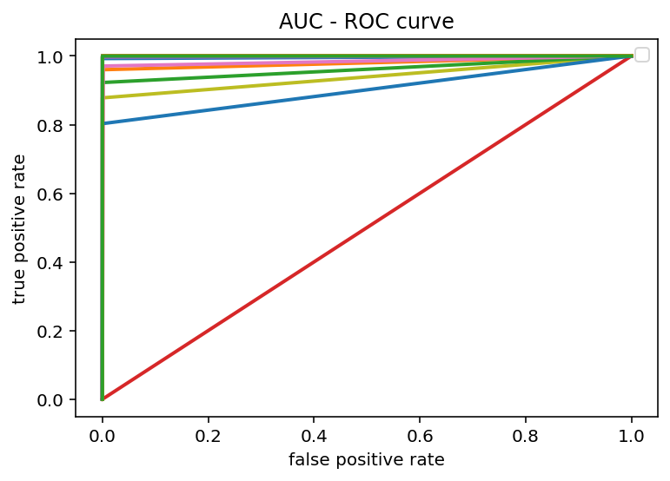
SVM AUC-Roc curve:

Slide 20
Conclusion:
On comparing the accuracy results of each algorithm we can infer that Random Forest algorithm has the highest Accuracy which is above 99.99% for this type of data set.
As a general observation supervised machine learning models give us higher accuracy.
This project can be further implemented on the live network to detect any malicious probing attacks.

